Slide 1
Process Simulation & Control using MATLAB and SIMULINK

Slide 2
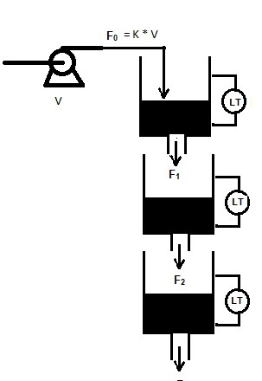
Mathematical Model of tank level system
Control objective:
Control the 3rd tank level by manipulating pump voltage V, where F₀ = K V
Add q₂ input flow on the tanks 2 and set q₂ as manipulated variable.
Which one is difficult to control?
Data for Simulation in Matlab/Simulink
A₁, A₃ = 28 cm² A₂ = 32 cm² V^{s} = 3 V
a₁ = 0.06725 cm² a₂ = 0.05683 cm² a₃ = 0.07089 cm² K=3.14

Slide 3
Creating S function
In Matlab Command window type <edit sfuntmpl>
>> edit sfuntmpl
It will open sfuntmpl.m file.
First line of the file is
function [sys,x0,str,ts,simStateCompliance] = sfuntmpl(t,x,u,flag)
Nice documentation is provided in this file describing the features.
Change the name of function ‘sfuntmpl’ to your function name. For eg., change to ‘tank3f’
Save the file in your working folder as tank3f.m

Slide 4
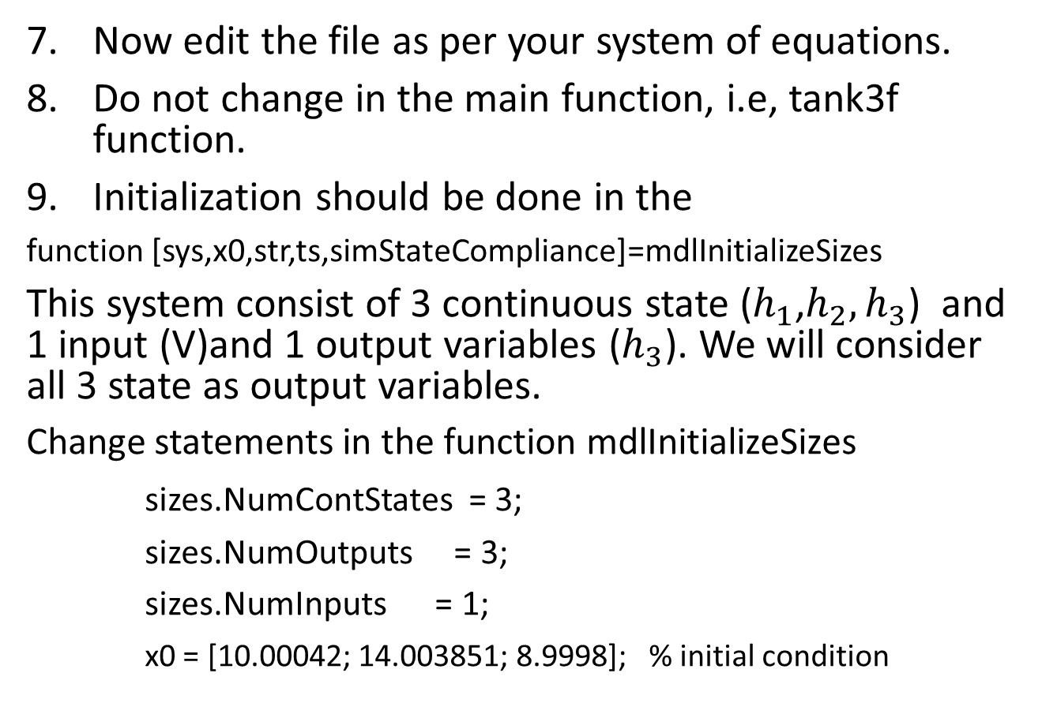
Creating S function (initialization)
Now edit the file as per your system of equations.
Do not change in the main function, i.e, tank3f function.
Initialization should be done in the
function [sys,x0,str,ts,simStateCompliance]=mdlInitializeSizes
This system consist of 3 continuous state ($h_{1}$,$h_{2},h_{3}$) and 1 input (V)and 1 output variables ($h_{3}$). We will consider all 3 state as output variables.
Change statements in the function mdlInitializeSizes
sizes.NumContStates = 3;
sizes.NumOutputs = 3;
sizes.NumInputs = 1;
x0 = [10.00042; 14.003851; 8.9998]; % initial condition

Slide 5
Creating S function (derivative)
Differential equations should be entered in
function sys=mdlDerivatives(t,x,u)
h1=x(1); %state 1: height in tank 1
h2=x(2); %state 2: height in tank 2
h3=x(3); %state 3: height in tank 3
F1=u; % Flow
% All the necessary parameters
A1=28;
A2=32;
A3=28;
a1=0.06725;
a2=0.05683;
a3=0.07089;
g=981;
% Parameters end

Slide 6
Creating S function (derivative)
% Compute xdot:
dh1dt =F1/A1 - (a1/A1)*sqrt(2*g*h1);
dh2dt = (a1/A2)*sqrt(2*g*h1) - (a2/A2)*sqrt(2*g*h2);
dh3dt = (a2/A3)*sqrt(2*g*h2)-(a3/A3)*sqrt(2*g*h3);
sys = [dh1dt;dh2dt;dh3dt];
sys=[der1;der2];
% end mdlDerivatives

Slide 7
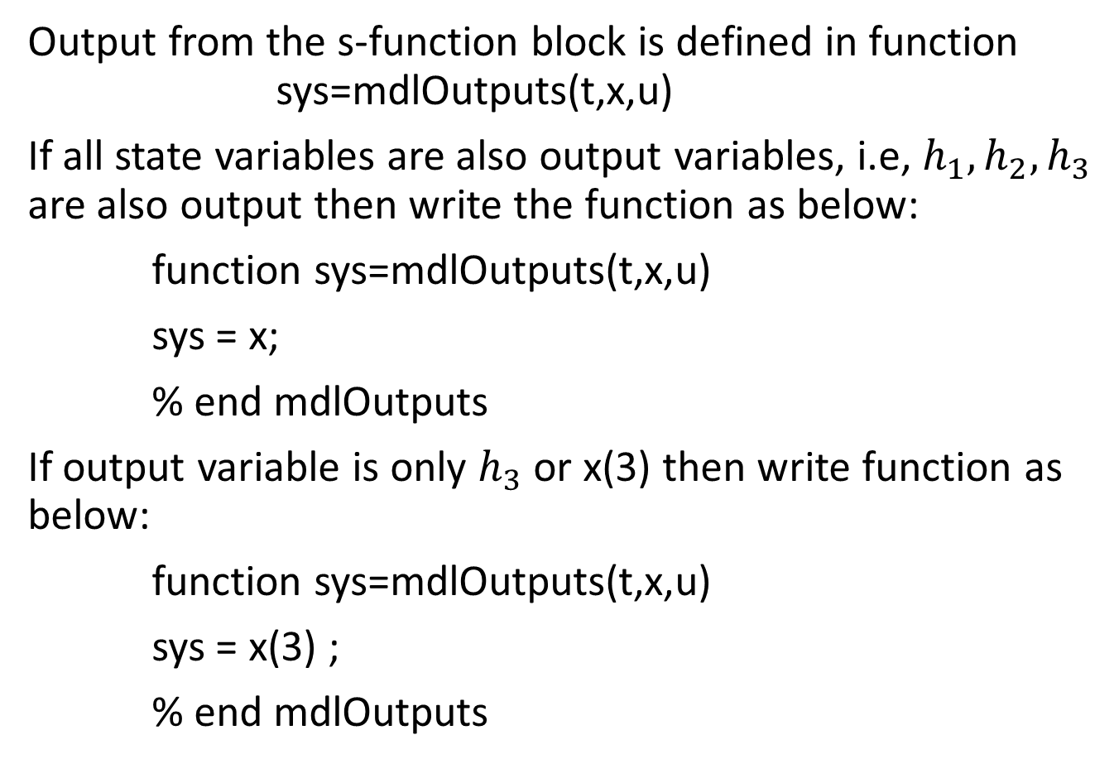
Creating S function (output)
Output from the s-function block is defined in function sys=mdlOutputs(t,x,u)
If all state variables are also output variables, i.e, $h_{1}, h_{2}, h_{3}$ are also output then write the function as below:
function sys=mdlOutputs(t,x,u)
sys = x;
% end mdlOutputs
If output variable is only $h_{3}$ or x(3) then write function as below:
function sys=mdlOutputs(t,x,u)
sys = x(3) ;
% end mdlOutputs

Slide 8
Simulink model
Save the tank3f.m after writing the functions as described in earlier slides.
Open Simulink model either
typing <simulink> in the command window
>> simulink
or click <Home> -> <new> -> <simulink model>
Click on <blank model> to open blank model
Open library browser under tools menu. This will open built-in library function block available
Drag the s-function block from the library browser to the model window.

Slide 9

Simulink model
This will show in the model window as below
The system name should be changed by double clicking on the s-function block in the model window
Change the s-function
Name from ‘system’ to
‘tank3f’.

Slide 10
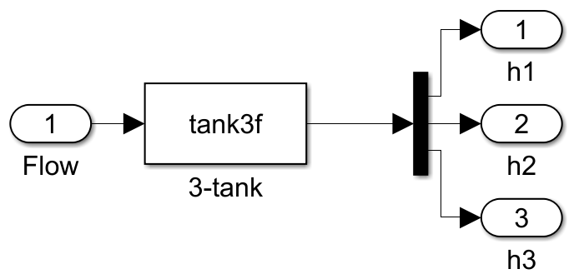
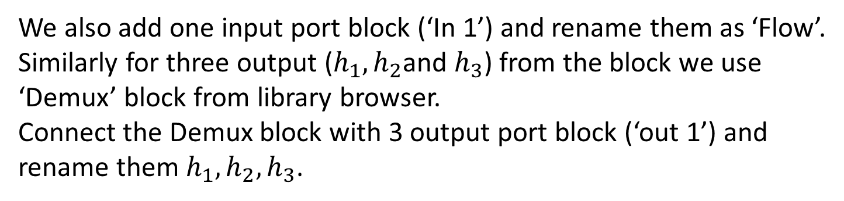
Simulink model
Now add input and output connection to the block.
We also add one input port block (‘In 1’) and rename them as ‘Flow’.
Similarly for three output ($h_{1}, h_{2}$and $h_{3}$) from the block we use
‘Demux’ block from library browser.
Connect the Demux block with 3 output port block (‘out 1’) and
rename them $h_{1}, h_{2}, h_{3}$.

Slide 11
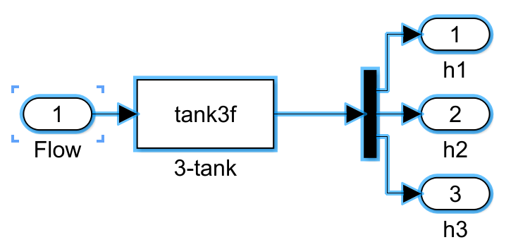
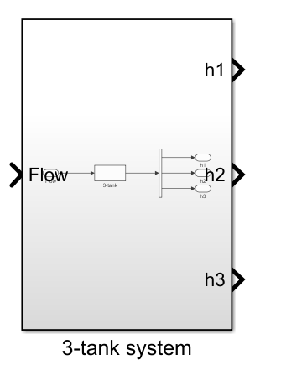
Simulink model (subsystem creation)
Select all the elements and block by pressing <ctrl> and A at the same time.
Create subsystem by clicking on ‘Create Subsystem’ under diagram menu and remove the ports and connecting lines.

Slide 12
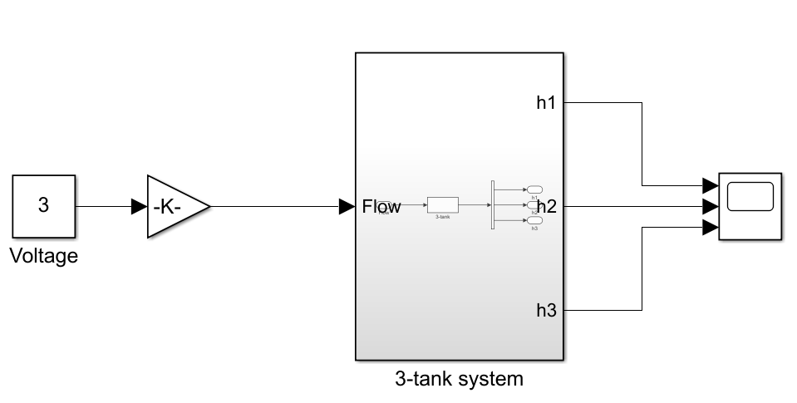
Simulink model (running 3-tank model)
Add input connection to the 3-tank system for Flow using ‘gain’and ‘const’ block and set values of gain as 3.14 and const as 3.
Add ‘Scope’ block, modify scope block with 3 input port and connect outpout ports of 3-tank system block

Slide 13
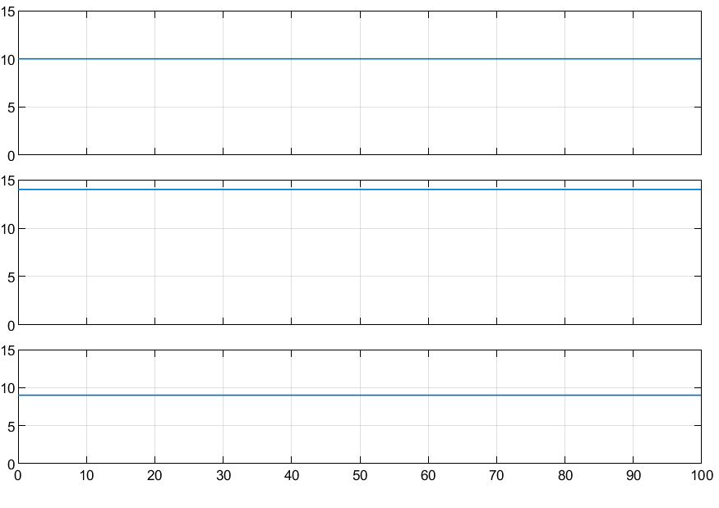
Simulink Model 3-tank (Result)
Run the simulation for 100 mins
h₁
h₂
h₃

Slide 14
Process with instrumentation
The simulation of the 3-tank level system is the basic process simulation where no instruments are attached to the process.
Most of the time we do control analysis based on this kind of process behavior/simulation because instrument gain and dynamics are neglected.
However, it is advised to include instrument dynamics in the overall process behavior so that any disturbances/noise due to instruments can be considered while designing/tuning the control system.

Slide 15
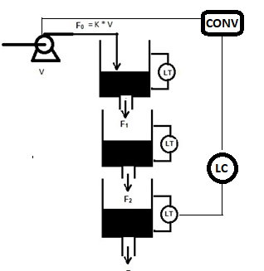
Process with instrumentation
1-5 V
4-20 mA
4-20 mA
Composition Analyzer
1. What should be the gain of the level measurement?
2. What is the measurement noise?
3. What is the measurement delay?

Slide 16
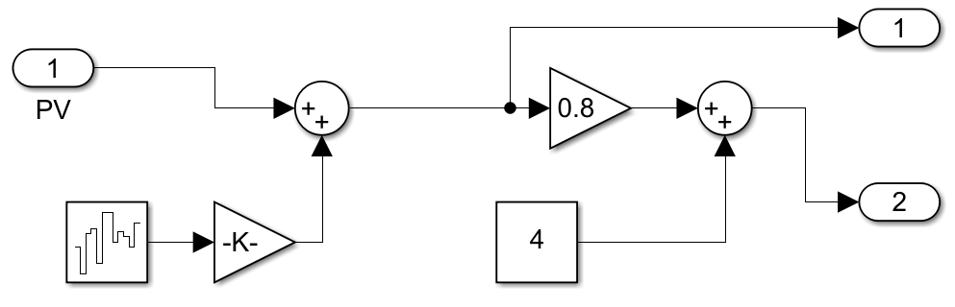
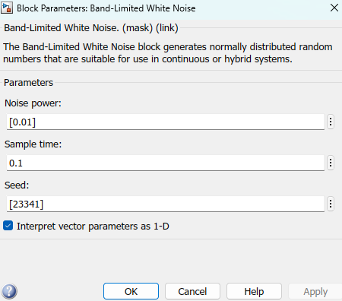
Sensor block : Simulink diagram
0.01
Noise signal
Create Subsystem
Level measurement Gain
Input : 0-20 cm
Output : 4-20 mA
Gain = 16/20 = 0.8

Slide 17
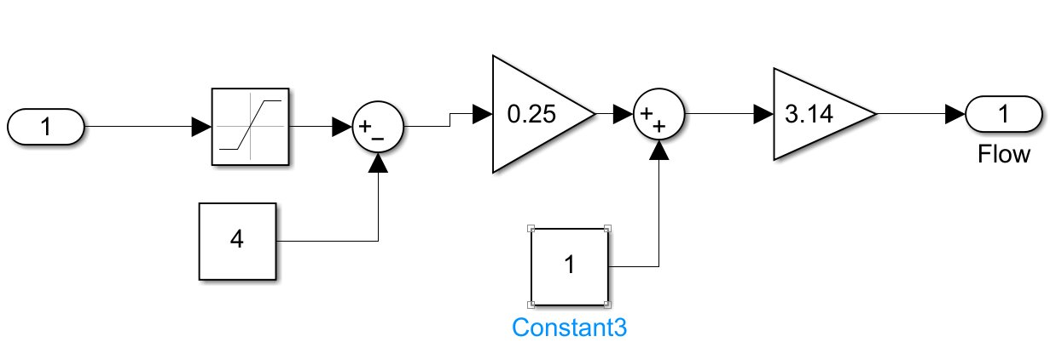
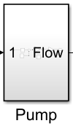
Pump: Simulink Diagram
Saturation
4-20
Create Subsystem

Slide 18
PID Controller Block
Simulink has a built-in PID controller block.
This block can be configured as P or PI or PD or PID controller
However, this block needs to be augmented with setpoint and bias.
Since, setpoint will be given in terms of process variable, measurement block gain needs to be included.

Slide 19
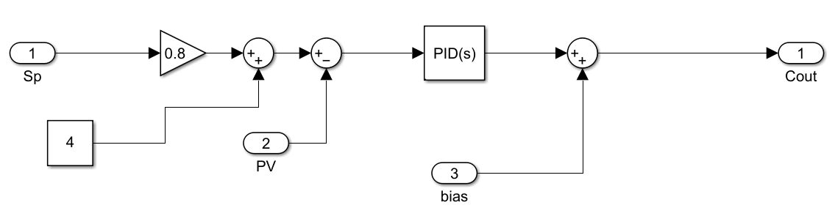
PID Controller: Simulink
Create Subsystem

Slide 20
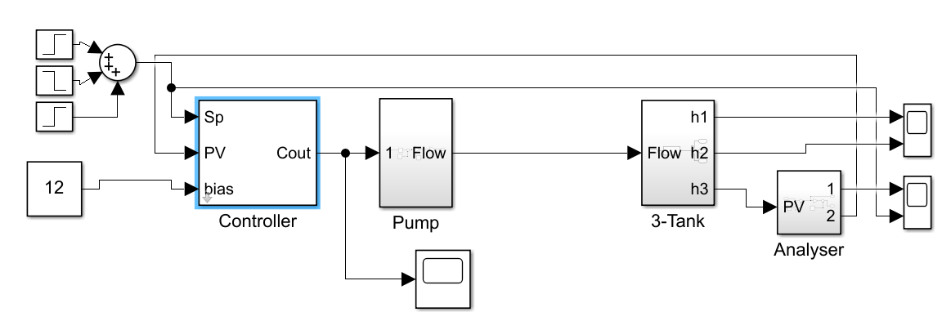
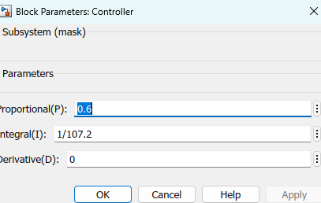
Feedback Control Block diagram in Simulink
Proportional Gain : 0.6
Integral Time constant : 107.2

Slide 21
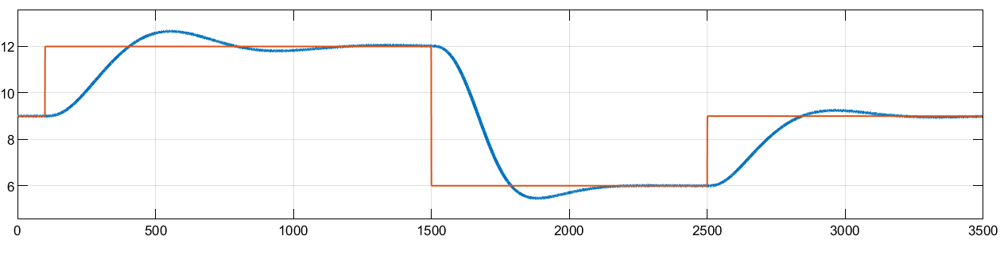
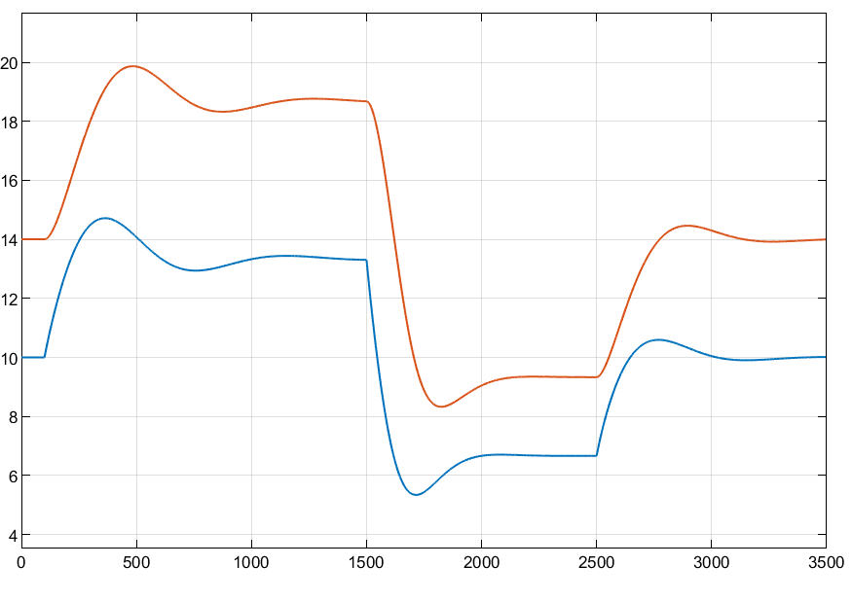
3rd tank level under PI control
1st and 2nd tank level

